Slide 1



2024 Website UI update analysis
Alvaro & Moana

Slide 2

Digital solutions for a digital Vanguard.
The digital world is evolving, and so are Vanguard’s clients. Vanguard is testing a new website UI designed to make the process of making an account smoother.
We conducted an A/B test of a sample of online users during a three month period.
Control: Clients using the current online portal design
Test: Clients using the new interface
Our analysis asks:
Did the new UI lead to higher completion rates?
Did users need less time to complete the process, and did they encounter less errors along the way?

Slide 3




Client Profiles
DATASETS & CLEANING
Demographic information linking client ID numbers to personal information such as age, account balance, and length of tenure
We chose to dropg entries for clients with missing age information and those who did not participate in the A/B test.
Digital Footprints
Experiment Roster
Large datasheet detailing each time the client logged on to the platform and each step they encountered throughout the process, including timestamps.
List of unique client ids and their assignment to either the test or control group
Dataset was filtered to only include those clients whose information included their start time. In cases where multiple start and confirm stages were logged, we considered the most recent.
This dataset was merged with the client profile datasheet, client IDs not present in the experiment roster were filtered out.

Slide 4





Our Clients

Slide 5



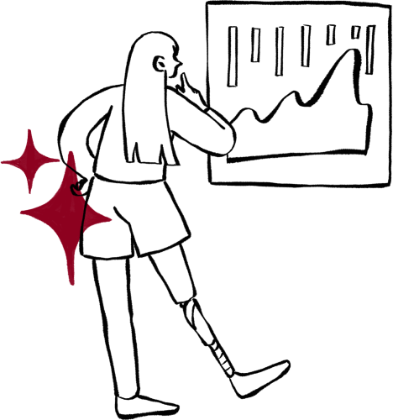
Nearly even split between women and men
Average client is fairly new - just under a year of tenure
Median age is 47
Median balance is $6333
Average number of accounts: 2

Slide 6

Completion Rate
Average number of clients who complete the process should increase by at least 5%
Speed
Average time clients spend to complete the process should decrease by at least 5%
Error Rate
Average amount of errors clients encounter along the process should decrease by at least 5%
Performance Metrics:
In order to justify the implementation of the new design, Vanguard expects to see a improvement of at least 5% in the following three metrics:

Slide 7


Hypothesis Testing - Completion rate
Null Hypothesis (H0): Average number of clients reaching the confirm stage in the test group was equal to or less than the control group.
Alternative Hypothesis (H1): Average number of clients reaching the confirm stage in the test group was greater than the control group.
We perform a t-test with alpha = 5%
p-value ~ 0
Not enough evidence to reject H0 - Completion rates rose, but not by a significant enough amount.

Slide 8


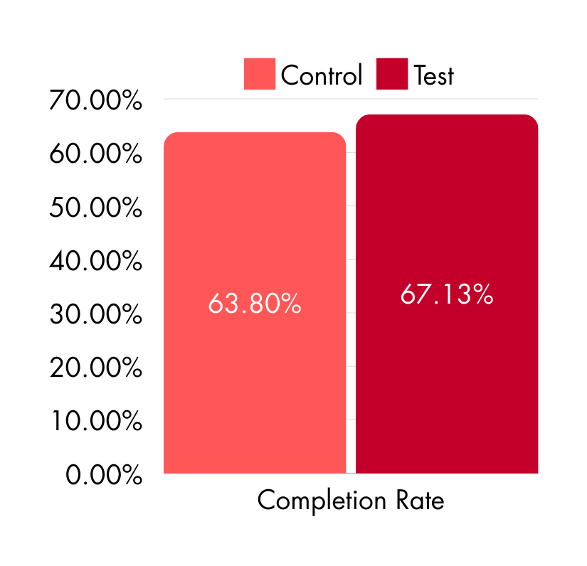
Perfomance Metrics: Completion Rate
Notes:
Completion rate in the test group rose slightly, but not significantly.

Slide 9
Hypothesis Testing - Median Time
Null Hypothesis (H0): The median time for the Test group is equal to or greater than the median time for the Control group.
Alternative Hypothesis (H1): The median time for the Test group is less than the median time for the Control group.
We perform a Mann-Whitney U Test with alpha = 5%
p-value ~ 0
Reject the null hypothesis - the median time for Test is significantly less.

Slide 10

Hypothesis Testing - Mean Time
Null Hypothesis (H0): The mean time for the Test group is equal to or greater than the mean time for the Control group.
Alternative Hypothesis (H1): The mean time for the Test group is less than the mean time for the Control group
We perform a t-test with alpha = 5%
p-value ~ 0,977
Fail to reject the null hypothesis - no significant evidence that the mean time for
Test is less.

Slide 11
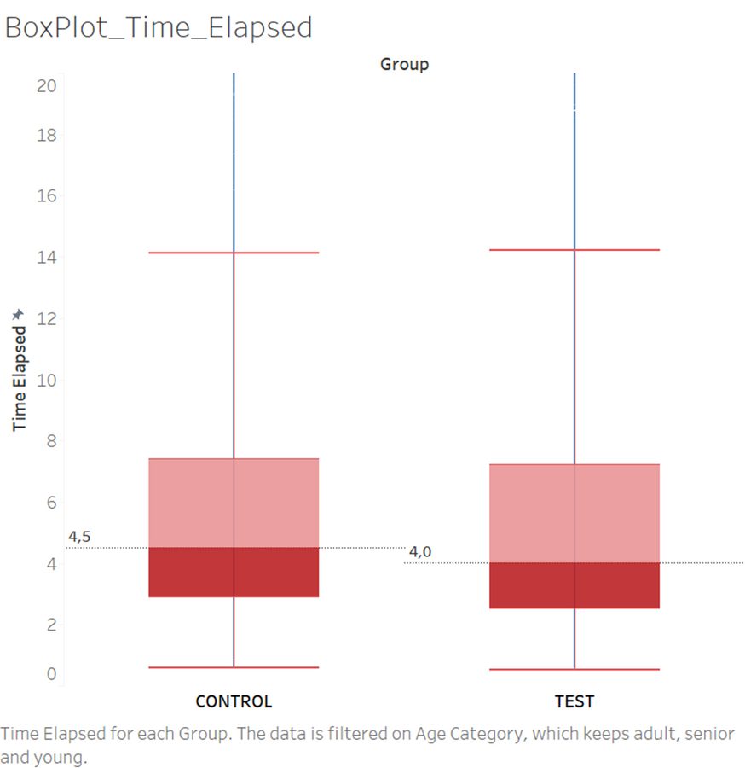
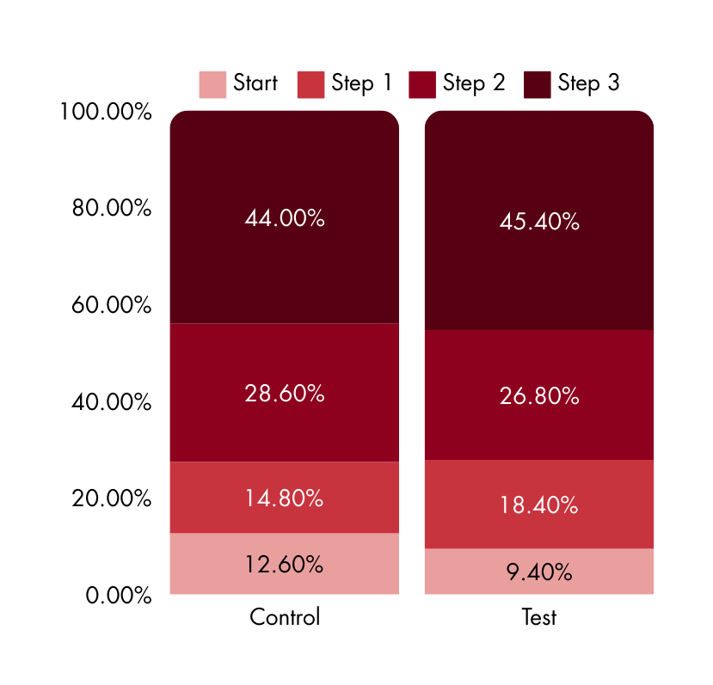
Analysis: Time spent to complete the process
% Duration of Each Process Step

Slide 12
Hypothesis Testing - Average Error Rate
H0 = Average number of errors per user in the test group was equal to or greater than the control group
H1 = Average number of errors per user in the test group was less than the control group
We perform a t-test with alpha = 5%
p-value ~ 0,98
Fail to reject the null hypothesis - no significant evidence that the error rate decreased.

Slide 13
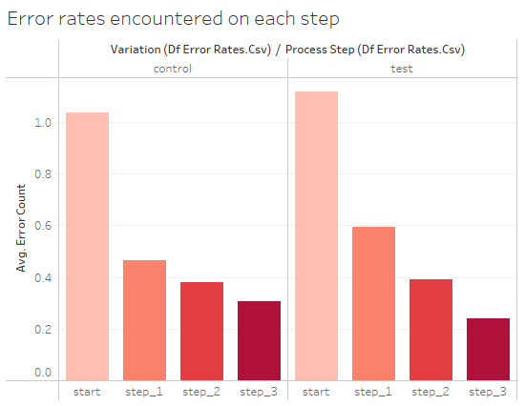
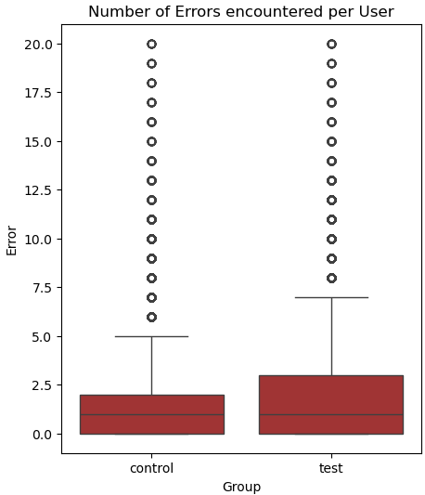
Analysis: Rate of Error
% Duration of Each Process Step
Notes:
Average rate of error increased slightly in the test group, though not significantly so. Median stayed the same.
Step 1 saw the greatest increase in errors when comparing the old to new UI.

Slide 14

Teamwork & Project Management
Workflow went smoothly with only two people
We found it useful to check in at the start and end of the workday
Nice to have such long, unstructured blocks in the day so that we could delegate the time as needed
Challenges & Learnings
Found halfway through the process that a significant part of the data did not correspond to the diagram we were given (clients without a start, clients jumping from Start to Step 2, etc...), had to reformulate our completion rate calculations accordingly
Issues getting data to show up correctly in Tableau, found it was easier to export smaller sets of data rather than working with the large dataset

Slide 15

CONCLUSIONS
Although the COMPLETION RATE is higher for the Test group, this difference is not statistically significant.
The MEDIAN DURATION for completing the test is significantly shorter for the Test group compared to the Control group.
We cannot conclude that the MEAN DURATION differs significantly between the two groups.
The AVERAGE ERROR RATE slightly increased between the Control and Test groups, the difference was not statistically significant.
Users in the Test group encountered significantly more ERRORS in STEP 1 compared with the Control group.
STEP 3 is where customers SPENT THE MOST TIME in both groups.

Slide 16
RECOMMENDATIONS
Despite a decrease in median duration for the Test group, the new UI unfortunately failed to boost completion rates or reduce error rates; it requires a full redesign before its implementation can be justifiable
Redesign should focus especially on Step 3 (where users spend the most time) and Step 1 (where user error increased with the website update)
Significant changes are essential if Vanguard is to consider their new UI as an improvement on user experience and in alignment with our success targets.

Slide 17

Thank You!
Alvaro & Moana

